Slide 1
Quality Standards for Services Supporting Male Victims / Survivors of Sexual Violence

Slide 2
About LimeCulture CIC
LimeCulture Community Interest Company (CIC) is a specialist sexual violence training and development organisation that has been established to improve the competence and confidence of frontline professionals (and their agencies)working with victims of sexual violence through training and development initiatives, research and consultancy services
We now work with a variety of organisations helping them to develop both their strategic and operational response to sexual violence
Notes:
Timeline
Expectations
Evidence Required

Slide 3
SOME OF OUR CLIENTS
Notes:
Discuss from top down:
Government agencies
Sport organisations
SARC’s and PCCs
University work

Slide 4

The Quality Standards for Services Supporting Male
Victims / Survivors of Sexual Violence
Background
The case for quality standards
The development project
Notes:
BACKGROUND
After year on year increases in reported sexual offences against males, the CEOs of four specialist services, Survivors Manchester, Safeline, Mankind & SurvivorsUK, came together to form Male Survivors Partnership (MSP):
In 2017 Lloyds Bank Foundation England & Wales funded the MSP to develop Quality Standards for Services Supporting Male Victims/Survivors of Sexual Violence
They also funded the development of an Independent Accreditation Programme to be trialed with10 services across England & Wales.
LimeCulture was commissioned by MSP to write the Quality Standards and deliver the Independent Accreditation Programme
THE CASE FOR QUALITY STANDARDS
Whilst making the case for the development of the Quality Standards, we received anecdotal feedback from:
Commissioners, who reported they wanted better tools to measure how funding earmarked for male victims/survivors was being used and wanted assurances of the quality of services being delivered
Service providers, who reported they often struggle to evidence the quality of the support they provide for male victims/survivors
Male victims/survivors, who reported they experienced barriers to accessing support and could not be assured of the quality of support that was available to them
THE PROJECT
We listened to the views and expertise of service providers, commissioners, academics and professionals during the development of the quality standards:
The LimeCulture visited 10 service providers supporting male victims/survivors throughout England & Wales
We held a series of consultation workshops with Commissioners, Service Providers and professionals working in the sector
Launched a national survey to gather the views of male victims/survivors about their t their experiences of accessing support services
Launched a consultation process on the draft Quality Standards and incorporated feedback from service providers, commissioners and academics

Slide 5
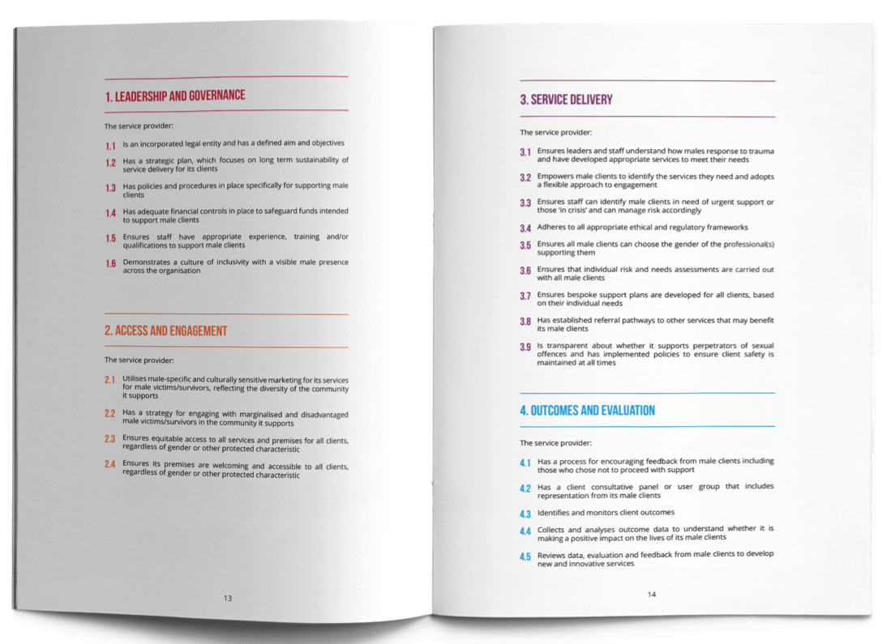
How the Standards are put together
There are 24 standards:
Leadership & Governance
Access and Engagement
Service Delivery
Outcomes & Evaluation

Slide 6
Meeting the Quality Standards
Each Quality Standard has ‘indicators’ covering the following groups
Leadership – Executive Officers, Trustees, Senior Managers
Staff – Frontline, local managers, volunteers
Clients – Former or current clients, service user groups, expert advisory panels
To achieve the Quality Standards, service provides will need to provide Documentary, Observational or Verbal evidence across each of these indicators

Slide 7
The Independent Accreditation Process
Monitoring
Self Assessment
07
01
Accreditation
06
02
Workshop
05
03
Final Report
04
Evidence Review
Site Visit
Notes:
LimeCulture’s Independent Accreditation Programme was designed as a 7-stage process of evaluation of service quality against the Quality Standards that includes a self assessment, submission of documentary evidence, and an observational site visit to capture evidence of each individual quality standard and the associated indicators from the leadership, staffing and male service user perspective.

Slide 8
Timeline to Accreditation
WORKSHOP
Services develop action plan
Provides clarity on requirements
Sets expectations & describes process
SITE VISIT
Opportunity for verbal and observational evidence
Focus groups leaders & staff
Client focus groups
MONITORING
Takes place at 12 and 24 months
Confirmation services continue to meet standards
Quality Mark retained to end of year 3
1 | 2 | 3 | 4 | 5 | 6 | 7 | 8 | 9 | 10 | 11 | 12
SELF-ASSESSMENT
Services complete self-assessment
Shows where work is required
Highlights areas for focus
EVIDENCE REVIEW
Services submit documentary evidence
Accreditation team assess and provide feedback & action plan
Second submission from service to address any outstanding areas
FINAL REPORT
Final report issued
Fully Met – Accredited
Met with Conditions - Accredited
Not Met – Not Accredited
Notes:
Following the site visit, the Independent Accreditation team will issue the service with a short report which includes:
Accreditation status:
Met
Met with conditions
Not Met
Any additional actions that need to be completed to meet the accreditation
(as detailed in the Site Visit debrief)
Met with conditions - where a service hasn’t had a user panel yet but has established one. Evidence will be required at the monitoring stage Year 1
Not Met – services may have a second site visit (additional fee) if further work is required to meet the evidential requirements

Slide 9
Evidence Guide
Quality Standard 1.1 | Indicators | Evidence Examples
The Service Provider is an incorporated legal entity and has a defined aim and objectives | 1.1.1 - Leaders comply with all regulatory and legal obligations on behalf of the organisation and ensure staff do so too | - Company Number or Charities Commission registration and up to date regulatory filings (DE) - Purpose and objective is visible in regulatory filings, annual reports and is accessible to clients and other stakeholders (DE) - Leaders and staff can articulate their understanding of the purpose and objective of the organisation (VE/OE) - Clients are made aware of the location of the organisations aims, objectives (DE)
 | 1.1.2 - Staff demonstrate an understanding of the organisation’s aim and objectives and work with leaders to achieve these
 | 1.1.3 - Clients can access the organisation’s aim and objectives in a format suitable to them

Slide 10
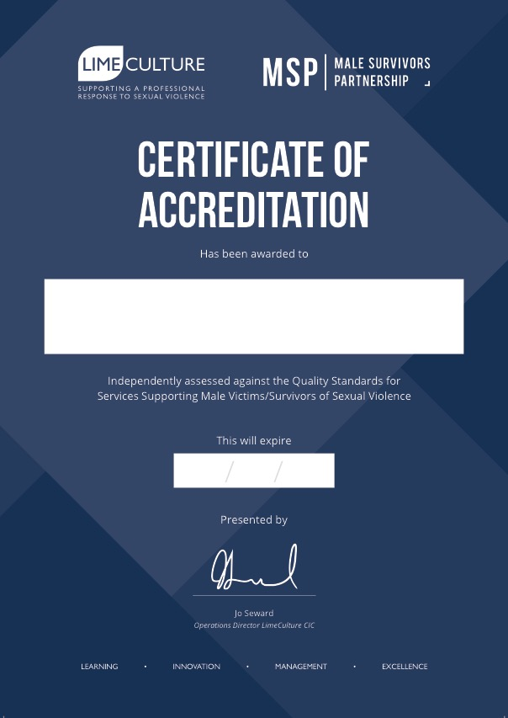
Quality Marks
xx/xx
Notes:
Following the site visit, the Independent Accreditation team will issue the service with a short report which includes:
Accreditation status:
Met
Met with conditions
Not Met
Any additional actions that need to be completed to meet the accreditation
(as detailed in the Site Visit debrief)
Met with conditions - where a service hasn’t had a user panel yet but has established one. Evidence will be required at the monitoring stage Year 1
Not Met – services may have a second site visit (additional fee) if further work is required to meet the evidential requirements

Slide 11
Key learning so far
Robust but supportive
Dedicated Accreditation Manager
Introduction of accreditation workshop – ideas, challenges & suggestions
Applicability of standards and requirement to meet all indicators
Differences within services – clarity about which services are enrolled
Multiple service enrolled options
Notes:
feedback from Wave 1 services has been excellent. Services have reported that they have found the accreditation process to be robust yet supportive in its approach. Each service has reported that they have received clear and unambiguous direction from LimeCulture’s Accreditation Team as to what level of evidence is required to demonstrate the Quality Standards are being achieved. LimeCulture has provided each service with an Accreditation Manager to work with the services and provide a clear action plan with identifiable timescales that explains what actions are required from the service.
Following the learning from the Wave 1 services, we have introduced an Accreditation Workshop into the process (at Stage 2) to allow services to come together at the beginning of the accreditation process. This provides an opportunity to fully explain the accreditation process, the requirements and the anticipated timeframes. It also allows the services to create a support network where they can share ideas, challenges and suggestions. Feedback from the Accreditation Workshops has suggested that this added element in the accreditation process has supported their input and engagement to the accreditation process.
It is clear that there are a number of organisations who provide multiple services for male victims/survivors (such as a single organisation who provides an ISVA Service and a Counselling Service, for example). The key piece of learning that has come out from the work of the Independent Accreditation Programme, is that while some providers of multiple services can achieve the Quality Standards in some services they deliver, they cannot in other services. Where this situation has occurred, it has been important that there is clarity around which service(s) have achieved the Quality Standards (and which have not) and which service(s) the Quality Mark applies to (and which it does not).
In order to protect the Quality Mark and the robust process associated with demonstrating that the Quality Standards have been achieved, LimeCulture has required all services within the Independent Accreditation Programme to identify exactly which service they wish to be included in the programme. Where multi-service organisation wants more than one of its services to be accredited, the 7-stage process will be consistently applied to each individual service to ensure compliance with the Quality Standards throughout each service.
A number of the current services in the Independent Accreditation Programme have requested the inclusion of additional services (that they deliver) in order to demonstrate that their other services are achieving the Quality Standards. A robust model has been developed by LimeCulture that allows providers of multiple services to achieve accreditation of more than one service against the Quality Standards. Where a multi-service provider can demonstrate compliance in more than one service, the Quality Mark will clearly identify which service(s) it applies to.

Slide 12
Progress to Date
Wave | Services enrolled | Start Date | Doc Evidence | Site Visit | Accredited
1 | 10 | April 2018 | 2 | 2 | 5
2 | 8 | November 2018 | 5 | 2 | -
3a | 6 | December 2018 | 6 | - | -
3b | 3 | February 2019 | 3 | - | -
4 | 12 | March 2019 | 12 | - | -
5 |  | June 2019
Notes:
The Quality Standards for Services Supporting Male Victims/Survivors of Sexual Violence were launched by Baroness Newlove, the Victims Commissioner for England and Wales, in the House of Lords in January 2018. At the same time, an application process was launched to allow 10 services supporting males to apply to join the independent accreditation programme (as ‘wave 1’ sites).
30 services applied to join the programme and become wave 1 sites. The following 10 services were selected (based on geographical coverage, support provided to males and service type) to join the programme in April 2018:
In autumn 2018, LimeCulture CIC was approached by NHS England Health and Justice Commissioners from South West, South Central and South East Coast area teams, requesting a range of their SARC and ISVA services join the Independent Accreditation Programme. Commissioners were keen to be assured that the services they commission in these regions could meet the needs of male victims/survivors.
Following discussions with commissioners, LimeCulture agreed to take on 2 further waves of services to join the Independent Accreditation Programme in 2018/19. This approach by local commissioners demonstrates their commitment to ensuring commissioned services are able to effectively support the needs of male victims/survivors.
In 2018/19, Male Survivors Partnership was awarded funding from the Home Office’s National Sexual Violence Fund for a further 10 services to join the Independent Accreditation Programme, thus increasing the coverage of services supporting male victims/survivors of sexual violence and achieving the Quality Standards.
In December 2018, LimeCulture opened a further application process to allow 10 new services to join the programme. Again, LimeCulture received applications from more services wishing to join the programme as Wave 4 (Home Office funded) services than available places on the programme. This demonstrates the commitment from the sector to reach accreditation against the Quality Standards.

Slide 13

Forward Look
A further funded wave (of up to 10 services)
Closing date for applications – 26th April
Services notified – 10th May
Accreditation workshop (Manchester) – 5th June
Notes:
Due to the overwhelming success of the Quality Standards and the support from commissioners and providers for the accompanying Independent Accreditation Programme, Lloyds Bank Foundation for England and Wales confirmed in February 2019, they would be funding Male Survivors Partnership again to allow a further 10 services to join LimeCulture’s Independent Accreditation Programme in an attempt to reach critical mass.
Services wishing to join the programme will need to compete a self-assessment document and submit it to us.
will prioritise services that will lead to an increased coverage of support for male victims/survivors.

Slide 14
https://limeculture.co.uk/accreditation/
http://www.malesurvivor.co.uk/male-service-standards/
Telephone: 0203 633 0018
Email: accreditation@limeculture.co.uk
Website: www.limeculture.co.uk
Twitter: @LimeCulture

